Slide 1

Mobile Image Processing
Hamed Ordibehesht
Mohammad Zand
Supervisor: Miroslaw Staron

Slide 2
Overview
Project Description and Assumptions
Image Processing Steps
Preprocessing
BLOB Detection
Feature Recognition
Efforts
Outcomes
Further Work

Slide 3
About The Project
A quick and dirty way of getting early indication of certain characteristics of the design
Processing Hand-Drawn Class-Diagram
Calculating some simple metrics such as structural complexity in a dirty way
Impact on quality of the architecture
Using Symbian Cell-phone
Proof of Concept
Applied IT Project
Solving an existing IT problem by applying scientific findings and techniques

Slide 4
Assumptions
Consistent drawing style
Rectangular class elements which are big enough to be recognized as features not noises
Drawing without textual elements
Using only horizontal and vertical lines

Slide 5
Processing Steps
Preprocessing
Noise Elimination
Edge detection
Shape refinement
BLOB Detection
Feature Recognition
Domain heuristics
Preprocessing
BLOB Detection
Feature Recognition

Slide 6
Preprocessing
Input: digital photo taken by the camera
Noise Elimination by
Applying symmetric Gaussian lawpass filter
hsize = 15
Sigma = 10
Values through empirical
Grayscaling
Resizing
Bicubic Interpolation
Antialiasing
Scale factor = 60%
Gaussian Filter
Grayscaling
Resizing
Edge Detection
Shape Refinement

Slide 7
Preprocessing (cont.)
Edge Detection with
Sobel operator for calculation of threshold value
Shape Refinement by Morphological operations
Dilation
Optimal Value = 3
Structuring elements => horizontal and vertical lines
Closing: combination of Dilation and Erosion
Optimal Value = 5
Structuring Elements => square
Output: Resampled image

Slide 8
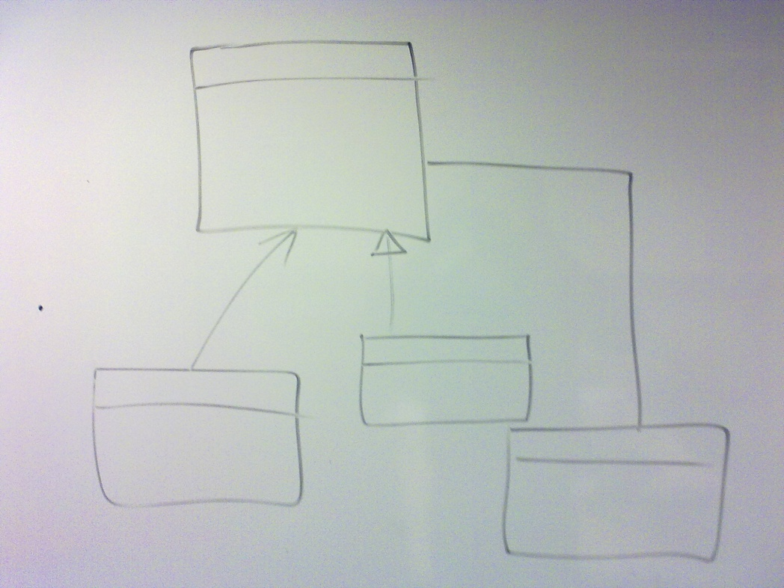
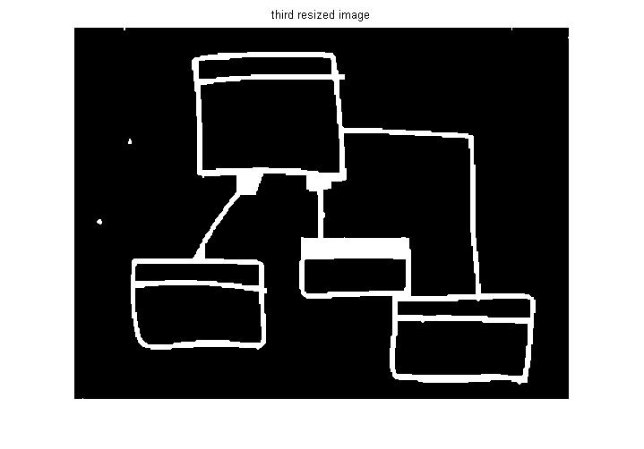
Preprocessing Output

Slide 9
BLOB Detection
Feature Detection
Connected Components
Labeling
Bounding Box calculation
Connected Components
Labeling
Framing

Slide 10
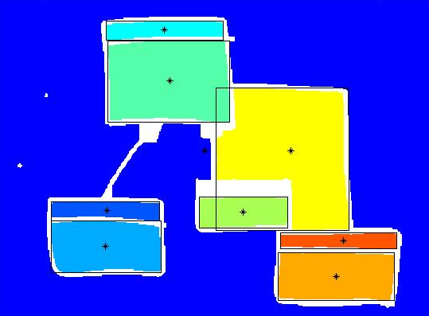
BLOB Detection Output

Slide 11
Feature Recognition
Recognition of the diagram elements
Count the number of classes
Process
Assumptions
Class element minimum bounding box size
Cross lines as
Domain Heuristics
Class elements do not intersect
A class element’s width ~> height
A Class element consist of maximum two segments which intersect or align

Slide 12
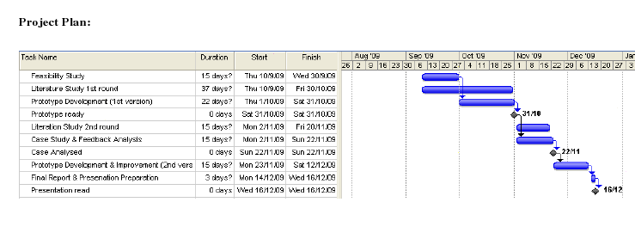
Project Plan

Slide 13
Efforts
580 hours
Reading LOTS of materials
Research around recent Image Processing Techniques
Learning how to work with MATLAB and Symbian developing
Developing and comparing some image processing methods
Blob Detection and Feature Extraction
Noise Elimination
Feature Recognition
Domain Heuristics

Slide 14
Outcomes
Novel noise elimination algorithm
Metrics collection result not accurate enough
Experiencing MATLAB
Symbian development experience
Still at development stage

Slide 15
Further Work
Work on the recognition algorithm for better accuracy
Development of Symbian application
Run an experiment

Slide 16
Thanks, Any Questions
?

